Slide 1
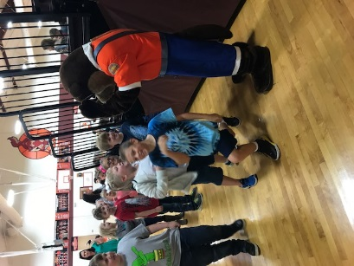
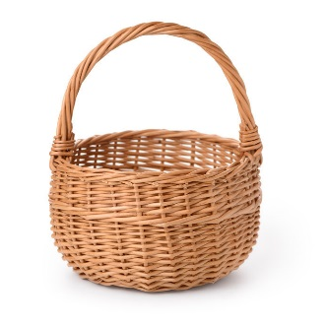
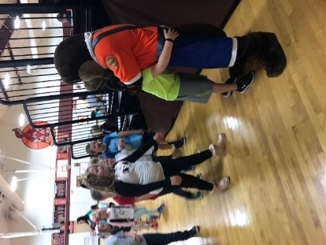
CLASSROOM NEWS
Week of October 16, 2018• danielleroderick@sevier.org
Mark Your Calendar
Ollie the Otter
Fall Festival Basket
We are still needing items for our “Around Town” basket. I am looking for any local tickets to local attractions. We only have this week. Thanks for your help!
Students learned about seat belt and road safety.
10/17-26 Book Fair
10/22-10/26 Anti-Bullying Week
10/22 Wear Red
10/23 Wear Peace Signs
10/24 Wear Favorite Sports Clothing
10/25 Wear a Hat
10/25 Progress Reports
10/25 Fall Festival
10/26 Wear School Colors
Math
Students will identify and continue patterns using concepts learned with place value in 3-digit numbers.
WHAT’S HAPPENING THIS WEEK
Vocabulary and Comprehension tests will be on Tuesday. Spelling, Phonics, and Grammar test will be on Wednesday.
Reading
Spelling Words
Vocabulary
Students will be identify text and graphic features in Animals Building Homes to help aid their comprehension.
1. next
2. end
3. camp
4. sank
5. sing
6. drink
7. hunt
8. stand
9. long
10. stamp
11. pond
12. bring
13. jump
14. left
15. young
16. friend
**Students may receive a differentiated list based on pretest results.
PHONICS SKILL:
1. shaped
2. branches
3. pond
4. beaks
5. deepest
6. break
7. hang
8. winding
Vocabulary Skill: PREFIXES re-, un-
It’s ok to not know,
but it’s not ok to not try.

