Slide 1
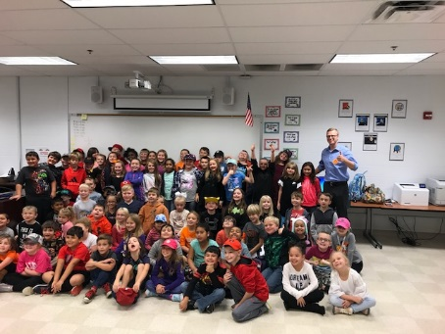
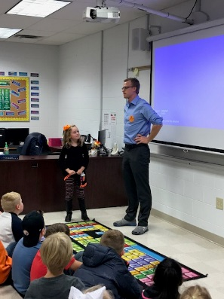
CLASSROOM NEWS
Week of October 29, 2018• danielleroderick@sevier.org
Mark Your Calendar
Meteorologist Visit
Students learned about weather events this week. They had some great questions for meteorologist, Trent Magill.
10/30 Picture Day
11/2 MUSE Presentation
11/6 NO SCHOOL; In-Service Day
11/12 No School
11/15 Grade Cards
11/15 Conferences 5-7
11/19 Porter Flats Field Trip
11/21 Thanksgiving Brunch / Reader’s Theater: Parents Invited to Attend
Math
Students will add and subtract two-digit numbers.
WHAT’S HAPPENING THIS WEEK
Vocabulary and Comprehension tests will be on Thursday. Spelling, Phonics, and Grammar test will be on Friday.
Reading
Spelling Words
Vocabulary
Students will identify the main idea of a text by using text features and repeated words.
1. dish
2. than
3. chest
4. such
5. thin
6. push
7. shine
8. chase
9. white
10. while
11. these
12. flash
13. which
14. then
15. catch
16. thumb
**Students may receive a differentiated list based on pretest results.
PHONICS SKILL: BASE WORDS AND ENDINGS –s, -ed, -ing
1. beware
2. damage
3. bend
4. flash
5. pounding
6. prevent
7. reach
8. equal
Vocabulary Skill: COMPOUND WORDS
It’s ok to not know,
but it’s not ok to not try.

