Slide 1
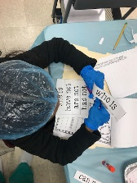
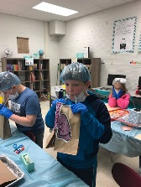
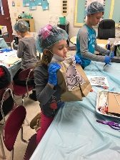
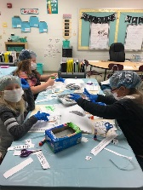
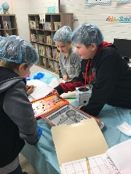
CLASSROOM NEWS
Week of December 3, 2018• danielleroderick@sevier.org
Mark Your Calendar
General Hospital
Last week students learned about fact and opinion, contractions, and three-digit addition in General Hospital.
12/13 Christmas Program at 6:00
Students need to be in their classrooms at 5:30.
12/17 Ugly Sweater Day
12/18 Christmas Hat/Sock Day
12/19 Favorite Christmas Character
12/20 Pajama/Polar Express Day
12/21 Clean-up Day & Favorite Christmas Shirt
12/22-1/7 Christmas Break
1/8 Welcome Back ☺
Christmas Program
Dec. 13th at 6:00
Students, be here by 5:30!
Math
Students will add and subtract using models and the vertical method.
Vocabulary and Comprehension tests will be on Tuesday. Spelling, Phonics, and Grammar test will be on Wednesday.
WHAT’S HAPPENING THIS WEEK
Reading
Students will distinguish between facts and opinions.
Spelling Words
Vocabulary
1. I’m
2. don’t
3. isn’t
4. can’t
5. we’ll
6. it’s
7. I’ve
8. didn’t
9. you’re
10. that’s
11. wasn’t
12. you’ve
13. us
14. them
15. they’re
16. wouldn’t
PHONICS SKILL: CVC Syllable Pattern
1. millions
2. choices
3. drift
4. simple
5. weaker
6. wrapped
7.disgusting
8. decide
Vocabulary Skill: Base Words and Suffixes –er, -est
Ex. bigger, biggest
smaller, smallest
It’s ok to not know,
but it’s not ok to not try.

