Slide 1
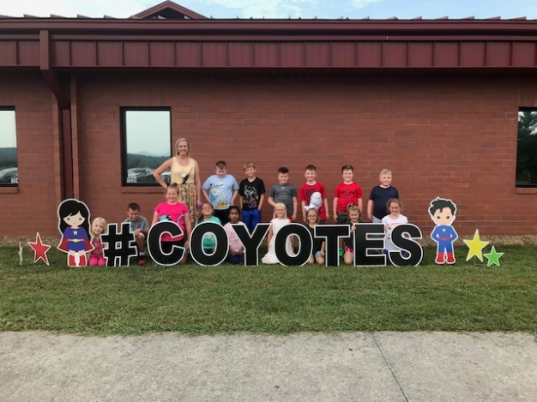
CLASSROOM NEWS
Week of August 20, 2018 • danielleroderick@sevier.org
Mark Your Calendar
We had a great first week!
I am so excited for this year. We had a great first week. I look forward to a lot of learning and sharing in our classroom. ☺
Please remember to send your child with a snack every day. We have a late lunch, and their tummies are getting rumbly well before then.
8/13 Open House/Registration 8/14 1st Day of School 8/20 wear red 8/21 wear blue 8/22 wear yellow 8/23 wear green 8/24 wear purple and/or gray 8/27 wear orange 8/28 wear black and white 8/29 wear rainbow or favorite color ​8/31 No School
Our first class picture.
Math
Students will decompose numbers to add and subtract fluently.
WHAT’S HAPPENING THIS WEEK
Spelling Words
Vocabulary
1. sad
2. dig
3. jam
4. glad
5. list
6. win
7. flat
8. if
9. fix
10. rip
11. kit
12. mask
13. as
14. his
15. sandwich
16. Picnic
**Students may receive a differentiated list based on pretest results.
PHONICS SKILL: SHORT VOWELS, CVC SYLLABLE PATTERN
1. curly
2. straight
3. floppy
4. drooled
5. weighed
6. stood
7. collars
8. row
Vocabulary Skill: ABC ORDER
Reading
Students will be inferring/predicting, and sequencing events in Henry and Mudge.
It’s ok to not know,
but it’s not ok to not try.

