Slide 1
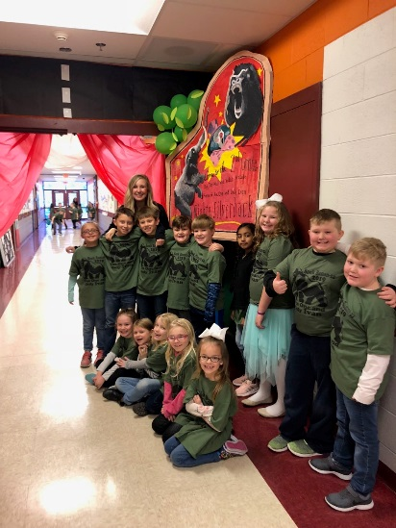
CLASSROOM NEWS
Week of February 4, 2019• danielleroderick@sevier.org
Mark Your Calendar
The One and Only Ivan
This week we are going to be reading in class. I will not be sending a reading log sheet for that reason.
2/8 Spirit and Pride Clothing Orders Due
2/11 Progress Reports
2/14 Valentine’s Day Party
2/15 Zoo Visits CES
2/18 In-Service Day; No School
2/22 Spring Pictures
Math
Students will add and subtract using models and the vertical method.
Spelling and vocabulary tests will be on next Thursday, and comprehension and grammar tests will be on Friday.. ☺
WHAT’S HAPPENING THIS WEEK
Reading
Students will describe the characters, setting, and events in sequential order.
Spelling Words
Vocabulary
running
clapped
stopped
hopping
batted
selling
pinned
cutting
sitting
rubbed
missed
grabbed
mixed
going
wrapped
swelling
1. received
2. budget
3. account
4. disappointed
5. chuckled
6. staring
7. repeated
8. fund
Vocabulary Skill:
Homographs
It’s ok to not know,
but it’s not ok to not try.

