Slide 1
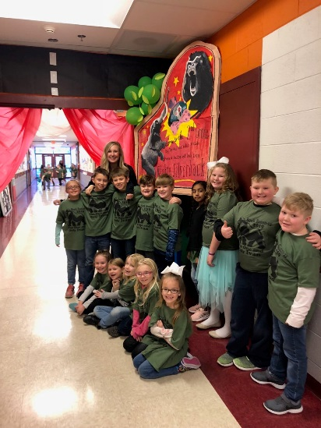
CLASSROOM NEWS
Week of February 11, 2019• danielleroderick@sevier.org
Mark Your Calendar
The One and Only Ivan
This week we are going to be reading in class. I will not be sending a reading log sheet for that reason.
2/11 Progress Reports
2/14 Valentine’s Day Party
2/15 Zoo Visits CES
2/18 In-Service Day; No School
2/22 Spring Pictures
2/28 Yearbook Orders Due
Valentine party on Thursday! Snack donations appreciated. Students may exchange valentines.
Math
Students will use repeated addition to find the sum of objects in an array.
**Review 3-digit Addition and Subtraction
Spelling and vocabulary tests will be on Thursday, and comprehension and grammar tests will be on Friday.. ☺
WHAT’S HAPPENING THIS WEEK
Reading
Students will describe the characters, setting, and events in sequential order.
Spelling Words
Vocabulary
running
clapped
stopped
hopping
batted
selling
pinned
cutting
sitting
rubbed
missed
grabbed
mixed
going
wrapped
swelling
1. received
2. budget
3. account
4. disappointed
5. chuckled
6. staring
7. repeated
8. fund
Vocabulary Skill:
Homographs
It’s ok to not know,
but it’s not ok to not try.

