Slide 1
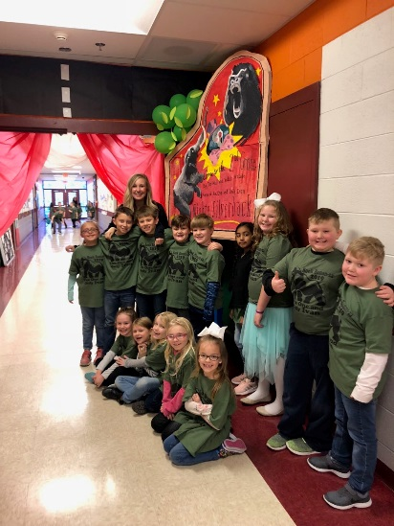
CLASSROOM NEWS
Week of February 18, 2019• danielleroderick@sevier.org
Mark Your Calendar
The One and Only Ivan
This week we are going to be reading in class. I will not be sending a reading log sheet for that reason.
2/22 Spring Pictures
2/25 Book Bonanza Shirts: Wear a long-sleeve shirt to wear under your child’s t-shirt.
2/26 Favorite Circus Character Day
2/27 Favorite Zoo Animal Day
2/28 Hero Day
2/28 Yearbook Orders Due
3/1 Favorite Book Character Day
3/4 Grade Cards
3/5 Conferences 5-7
3/6 MUSE Visit
3/12 Zoo Field Trip
3/13 MUSE Visit
Yearbook pre-sale will be through February 28th.
Math
Students will use repeated addition to find the sum of objects in an array.
**Review 3-digit Addition and Subtraction
Spelling and vocabulary tests will be on Thursday, and comprehension and grammar tests will be on Friday.. ☺ Next Week
WHAT’S HAPPENING THIS WEEK
Reading
Students will sequence events in a story.
Spelling Words
Vocabulary
night
kind
spy
child
light
find
right
high
wild
July
fry
sigh
by
why
behind
lightning
1. practice
2. hurried
3. position
4. roared
5. extra
6. curb
7. cheered
8. final
Vocabulary Skill:
Antonyms
It’s ok to not know,
but it’s not ok to not try.

