Slide 1
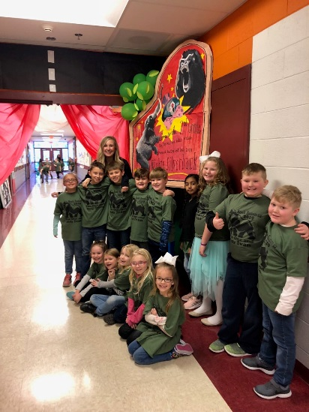
CLASSROOM NEWS
Week of February 25, 2019• danielleroderick@sevier.org
Mark Your Calendar
The One and Only Ivan
This week we are going to be reading in class. I will not be sending a reading log sheet for that reason.
2/27 Favorite Zoo Animal/Circus Character Day
2/28 Hero Day
2/28 Family Literacy Night 4-6
3/1 Favorite Book Character Day
3/4 Grade Cards
3/4 Yearbook Orders Due
3/5 Book Fair Shopping Day
3/5 Conferences 5-7
3/6 MUSE Visit
3/11 Class Picture Orders Due
3/12 Zoo Field Trip
3/13 MUSE Visit
Yearbook pre-sale will be through March 4th.
Math
Students will use data in a graph to problem solve.
**Review 3-digit Addition and Subtraction
Spelling, Comprehension, Vocabulary, and Grammar tests will be on Friday.
WHAT’S HAPPENING THIS WEEK
Reading
Students will sequence events in a story.
Spelling Words
Vocabulary
night
kind
spy
child
light
find
right
high
wild
July
fry
sigh
by
why
behind
lightning
1. practice
2. hurried
3. position
4. roared
5. extra
6. curb
7. cheered
8. final
Vocabulary Skill:
Antonyms
It’s ok to not know,
but it’s not ok to not try.

