Slide 1
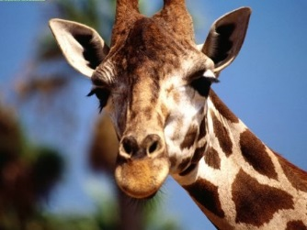
CLASSROOM NEWS
Week of March 11, 2019• danielleroderick@sevier.org
Mark Your Calendar
Please help our school by completing the
Parent & Family Survey.
English- (https://goo.gl/ZzGdQs) Spanish- (goo.gl/EUqvE6)
3/11 Class Picture Orders Due
3/12 Zoo Field Trip
3/13 MUSE Visit
3/28 Box Tops Due for March: Colored Hair Day
4/1-4/5 Spring Break: No School
4/10 Fire Safety Day
4/19 Half-Day of School: Dismissal at 10:45
Zoo field trip is on Tuesday, March 12th. Students should wear tennis shoes and a light jacket. They must bring their backpacks to carry their lunches. Folders and Reading books may be left at home on Tuesday, but returned on Wednesday.
Math
Students count money and problem solve using money amounts.
**Review 3-digit Addition and Subtraction
Spelling, Comprehension, Vocabulary, and Grammar tests will be NEXT WEDNESDAY.
WHAT’S HAPPENING THIS WEEK
Reading
Students use text and graphic features to better understand the events in the story.
Spelling Words
Vocabulary
car
dark
arm
star
park
yard
party
hard
farm
start
part
spark
art
jar
carpet
apartment
1. assistant
2. agreed
3. polite
4. failed
5. tearing
6. wisdom
7. cleared
8. trouble
Vocabulary Skill:
Synonyms; Shades of Meaning- Words that have the same meaning, but slight difference.
It’s ok to not know,
but it’s not ok to not try.

