Slide 1
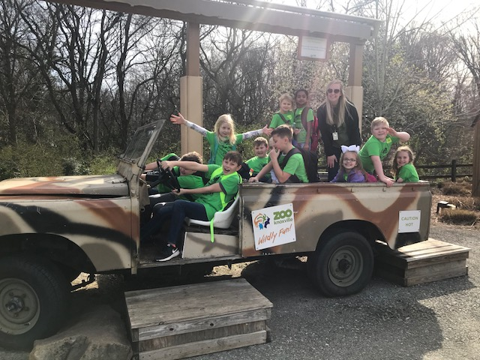
CLASSROOM NEWS
Week of March 18, 2019• danielleroderick@sevier.org
Mark Your Calendar
Please help our school by completing the
Parent & Family Survey.
English- (https://goo.gl/ZzGdQs) Spanish- (goo.gl/EUqvE6)
3/11-3/22 Leprechaun Wars
3/28 Box Tops Due for March: Colored Hair Day
4/1-4/5 Spring Break: No School
4/10 Fire Safety Day
4/19 Half-Day of School: Dismissal at 10:45
We had a WILD time at the zoo. Thank you to the chaperones for helping coral our class.
Students are participating in Leprechaun Wars through March 22nd. Good luck!
Math
Students count money and problem solve using money amounts.
**Review 3-digit Addition and Subtraction
Spelling, Comprehension, Vocabulary, and Grammar tests will be FRIDAY.
WHAT’S HAPPENING THIS WEEK
Reading
Students will compare and contrast characters and Dex to himself as he changes.
Spelling Words
Vocabulary
horn
story
fork
score
store
corn
morning
shore
short
born
tore
forget
for
more
report
force
1. depended
2. sore
3. sprang
4. studied
5. gazing
6. hero
7. exercise
8. overlooked
Vocabulary Skill:
Prefix over-
Understand a word with the known prefix, over-.
Ex. over meaning above, beyond
overeat- eat beyond fill
It’s ok to not know,
but it’s not ok to not try.

