Slide 1
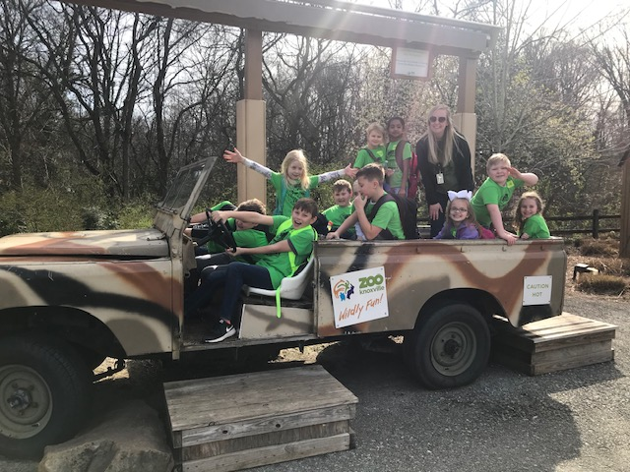
CLASSROOM NEWS
Week of March 25, 2019• danielleroderick@sevier.org
Mark Your Calendar
Please help our school by completing the
Parent & Family Survey.
English- (https://goo.gl/ZzGdQs) Spanish- (goo.gl/EUqvE6)
3/28 Box Tops Due for March: Colored Hair Day
4/1-4/5 Spring Break: No School
4/10 Fire Safety Day
4/19 Half-Day of School: Dismissal at 10:45
We had a WILD time at the zoo. Thank you to the chaperones for helping coral our class.
Math
Students will identify 2-D and 3-D shapes by their attributes: sides, angles, faces, edges and corners.
Spelling, Comprehension, Vocabulary, and Grammar tests will be FRIDAY.
Reading
WHAT’S HAPPENING THIS WEEK
Students will identify the main idea or central message of a passage and supporting details.
Spelling Words
Vocabulary
father
over
under
herd
water
verb
paper
cracker
offer
cover
germ
master
fern
ever
remember
feather
1. webbed
2. waterproof
3. steer
4. whistle
5. otherwise
6. junior
7. slippery
8. finally
Vocabulary Skill:
Dictionary Entry
It’s ok to not know,
but it’s not ok to not try.

