Slide 1
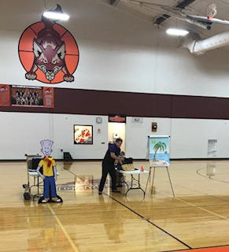
CLASSROOM NEWS
Week of September 3, 2018• danielleroderick@sevier.org
Mark Your Calendar
We have a growth mindset!
Last week students learned how to have a growth mindset during our NED visit. Students learned to never give up, encourage others, and do their best.
Please remember to send your child with a snack every day. We have a late lunch, and their tummies are getting rumbly well before then.
9/3 No School
9/4 Spirit Wear Orders Due
9/7 Early Dismissal at 2:00
9/11 Progress Reports
9/14 Early Dismissal at 2:00
10/2 Report Cards
10/4 Conferences 4-6
10/12 Vacation: No School
10/15 Vacation: No School
10/25 Fall Festival
NED speaker teaching students how to have a growth mindset.
Math
Students will decompose numbers to add and subtract fluently.
WHAT’S HAPPENING THIS WEEK
Spelling Words
Vocabulary
1. wet
2. job
3. hug
4. rest
5. spot
6. mud
7. left
8. help
9. plum
10. nut
11. net
12. hot
13. get
14. not
15. lunch
16. spend
**Students may receive a differentiated list based on pretest results.
PHONICS SKILL: SHORT VOWELS, CVC SYLLABLE PATTERN
1. remembered
2. porch
3. crown
4. spend
5. stuck
6. visit
7. cousin
8. piano
Vocabulary Skill: Using a Glossary
Reading
Students will be comparing and contrasting, and questioning in My Family.
It’s ok to not know,
but it’s not ok to not try.

