Slide 1
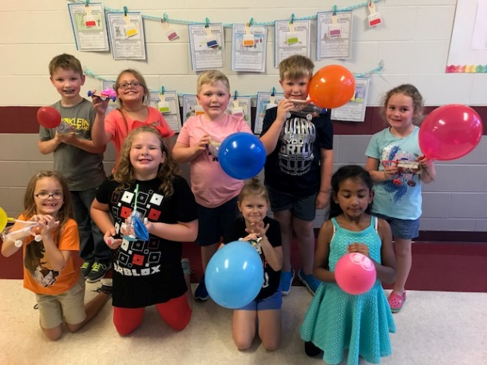
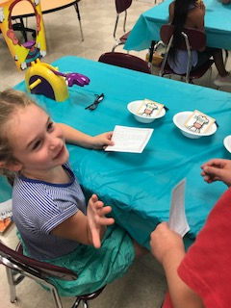
CLASSROOM NEWS
Week of September 17, 2018• danielleroderick@sevier.org
Mark Your Calendar
BALLOON CAR ENGINEERS
Students explained their designs for the balloon car project. They did a fabulous job explaining their design and the materials they used. Thanks for all your help with this project!
10/2 Report Cards
10/4 Conferences 4-6
10/12 Vacation: No School
10/15 Vacation: No School
10/25 Fall Festival
Math
Students will continue to count numbers up to 1,000, and write numbers in unit form, word form, and expanded form.
Students will take Spelling/Comprehension Tests on Tuesday and Phonics/Grammar on Wednesday.
WHAT’S HAPPENING THIS WEEK
Reading
Spelling Words
Vocabulary
Students will be identifying author’s purpose, comparing and contrasting, and evaluating comprehension in Dogs.
1. cake
2. mine
3. plate
4. size
5. ate
6. grape
7. prize
8. wipe
9. race
10. line
11. pile
12. rake
13. gave
14. bike
15. mistake
16. while
**Students may receive a differentiated list based on pretest results.
PHONICS SKILL: LONG VOWELS A, I ; SOUNDS FOR C
1. hairy
2. mammals
3. litter
4. stayed
5. canned
6. chews
7. clipped
8. coat
Vocabulary Skill: Multiple Meaning Words
It’s ok to not know,
but it’s not ok to not try.

