Slide 1
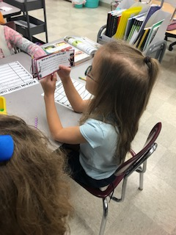
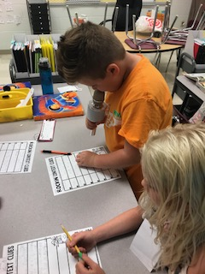
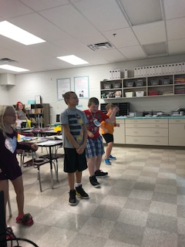
CLASSROOM NEWS
Week of September 24, 2018• danielleroderick@sevier.org
Mark Your Calendar
ROCKIN’ CONTEXT CLUES
Students identified rock and roll vocabulary words using context clues in a text. They also participated in rock and roll themed CVCe words. They rocked it for Rock Your School day!
10/2 Report Cards
10/4 Conferences 4-6
10/12 Vacation: No School
10/15 Vacation: No School
10/25 Fall Festival
Math
Students will continue to count numbers up to 1,000, and write numbers in unit form, word form, and expanded form.
These skills will be tested on Friday, September 28th.
WHAT’S HAPPENING THIS WEEK
Reading
Spelling Words
Vocabulary
Students will be identifying cause and effect, identifying figurative language, and summarizing in Diary of a Spider.
1. doze
2. nose
3. use
4. rose
5. pole
6. close
7. cute
8. woke
9. mule
10. rode
11. role
12. tune
13. home
14. joke
15. wrote
16. ice cube
**Students may receive a differentiated list based on pretest results.
PHONICS SKILL: LONG VOWELS O,U,E; SOUNDS OF G
1. insects
2. dangerous
3. scare
4. sticky
5. rotten
6. screaming
7. breeze
8. judge
Vocabulary Skill: Context Clues
It’s ok to not know,
but it’s not ok to not try.

