Slide 1
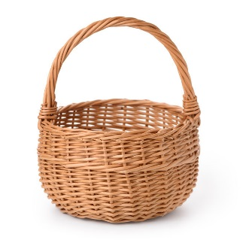
CLASSROOM NEWS
Week of October 8, 2018• danielleroderick@sevier.org
Mark Your Calendar
Ribbon-Cutting Ceremony
How exciting to have so many important leaders of our state and local government at our school! Students were pumped to celebrate and commit to living an active lifestyle.
Please let me know if you know of anyone who could donate tickets for local attractions for our fall festival basket.
10/8 Firefighter Presentation
10/9 MUSE Science Presentation
10/12 Vacation: No School
10/15 Vacation: No School
10/25 Fall Festival
Hope everyone has a nice Fall Break! Oct. 12-15
Math
Students will continue to work with comparing three-digit numbers. We will review place value concepts.
Vocabulary and Comprehension tests will be on Wednesday. Spelling, Phonics, and Grammar test will be on Thursday.
WHAT’S HAPPENING THIS WEEK
Reading
Spelling Words
Vocabulary
Students will be identifying story structure and visualizing story events with Teacher’s Pets.
1. spin
2. clap
3. grade
4. swim
5. place
6. last
7. test
8. skin
9. drag
10. glide
11. just
12. stage
13. slip
14. drive
15. climb
16. price
**Students may receive a differentiated list based on pretest results.
PHONICS SKILL:
1. wonderful
2. noises
3. quiet
4. sprinkled
5. share
6. noticed
7. bursting
8. suddenly
Vocabulary Skill: BASE WORDS AND ENDINGS –ed, -ing
It’s ok to not know,
but it’s not ok to not try.

